Slide 1

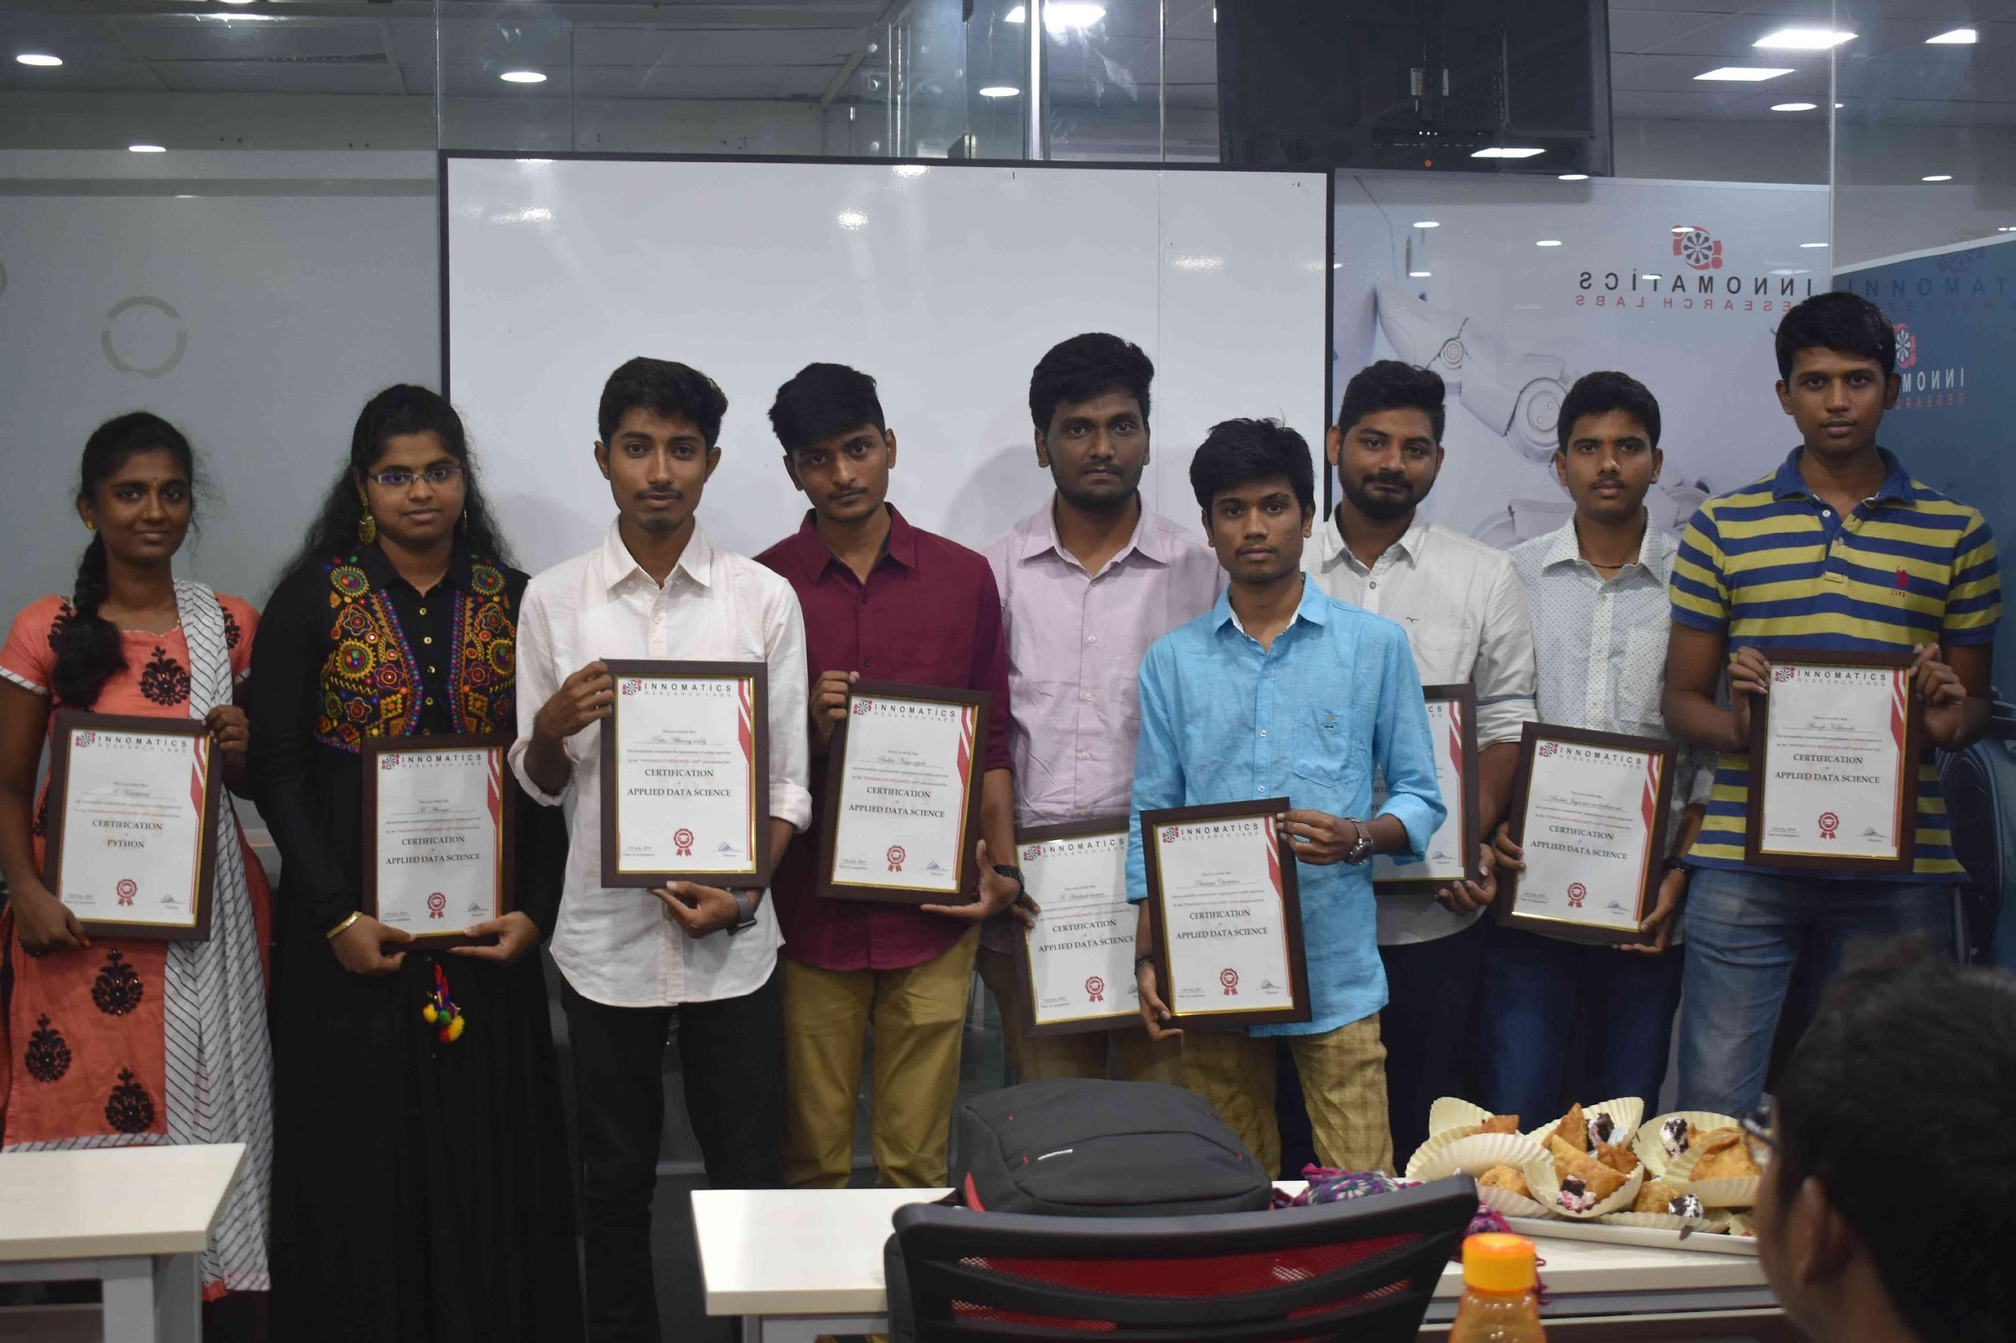
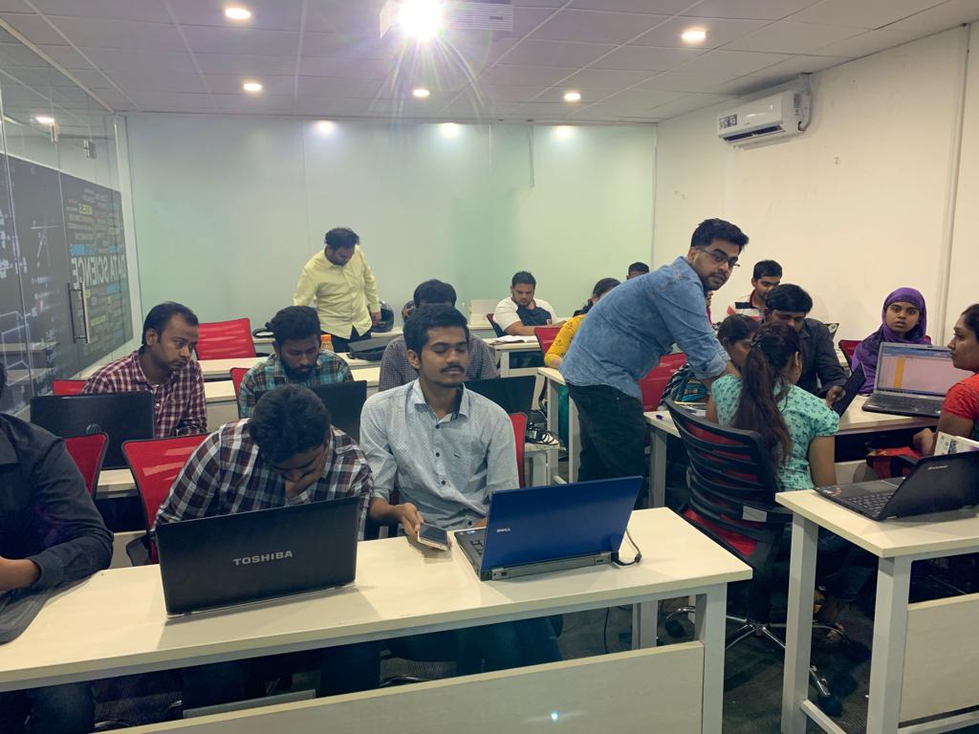

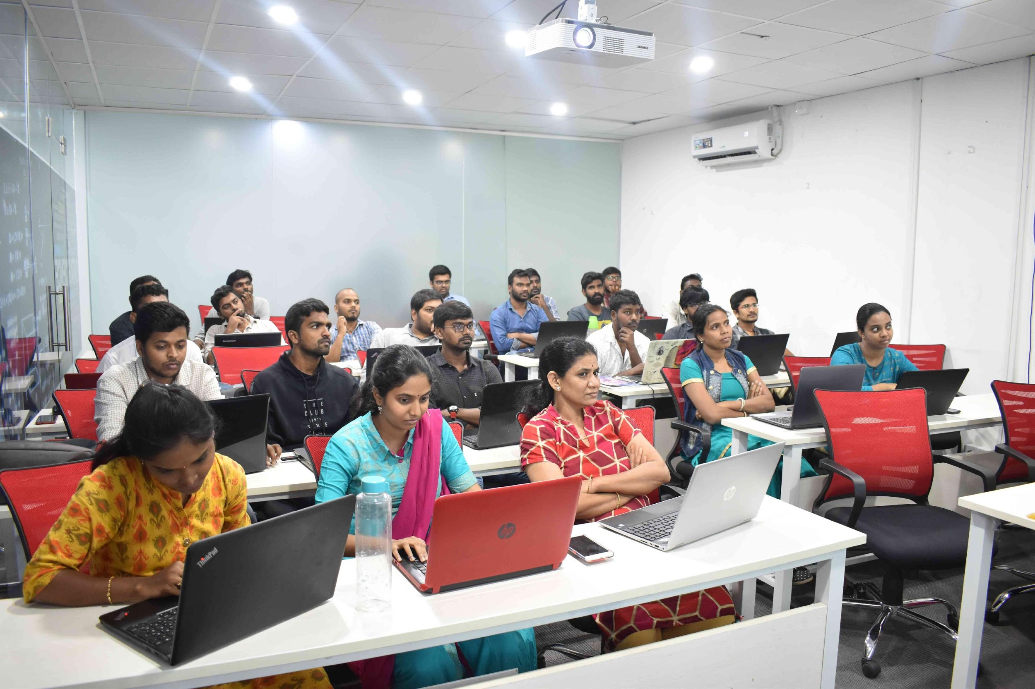
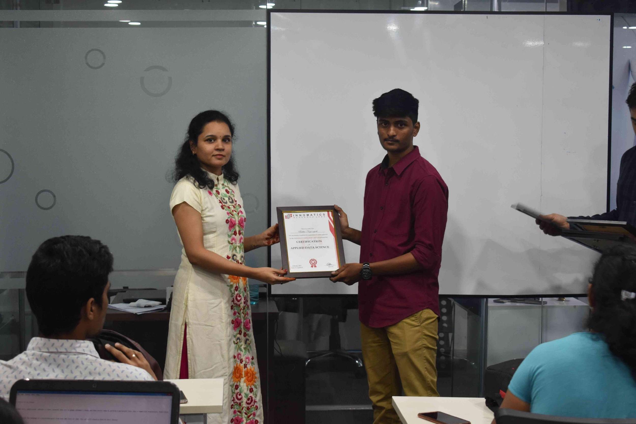
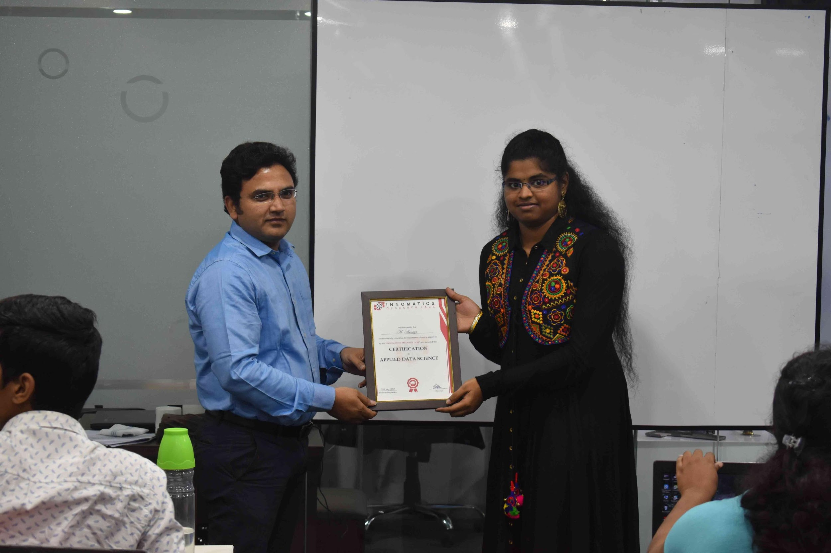

Slide 2
About me
First of All, Thank you for giving me this opportunity to introduce myself.
My name is Manuj Kumar Joshi. I am Basically from Nainital, Uttarakhand. I did my graduation in Computer Science from Bon Maharaj Engineering College (Under AKTU formally UPTU), Vrindavan, Uttar Pradesh in 2014.
I wanted to learn Data Science because Data science is the future, and it is better to be on the cutting-edge than left behind.
Experience:
I had a 1 month internship experience at The Sparks Foundation in Data Science and Business Analytics Domain
I had a 1 month internship experience at The Sparks Foundation in IoT and Computer Vision Domain
After 4 months of intense research on Internet I landed in Innomatics Research Labs because –
I was tempted by course module.
We were provided 2 hours of classes and 3 hours of doubt clearing interactive sessions everyday, I believe this will not leave any doubt regarding subjects.
Mentors were themselves Data Scientists, so I can believe they know what is required as per Industry Standards.

Slide 3
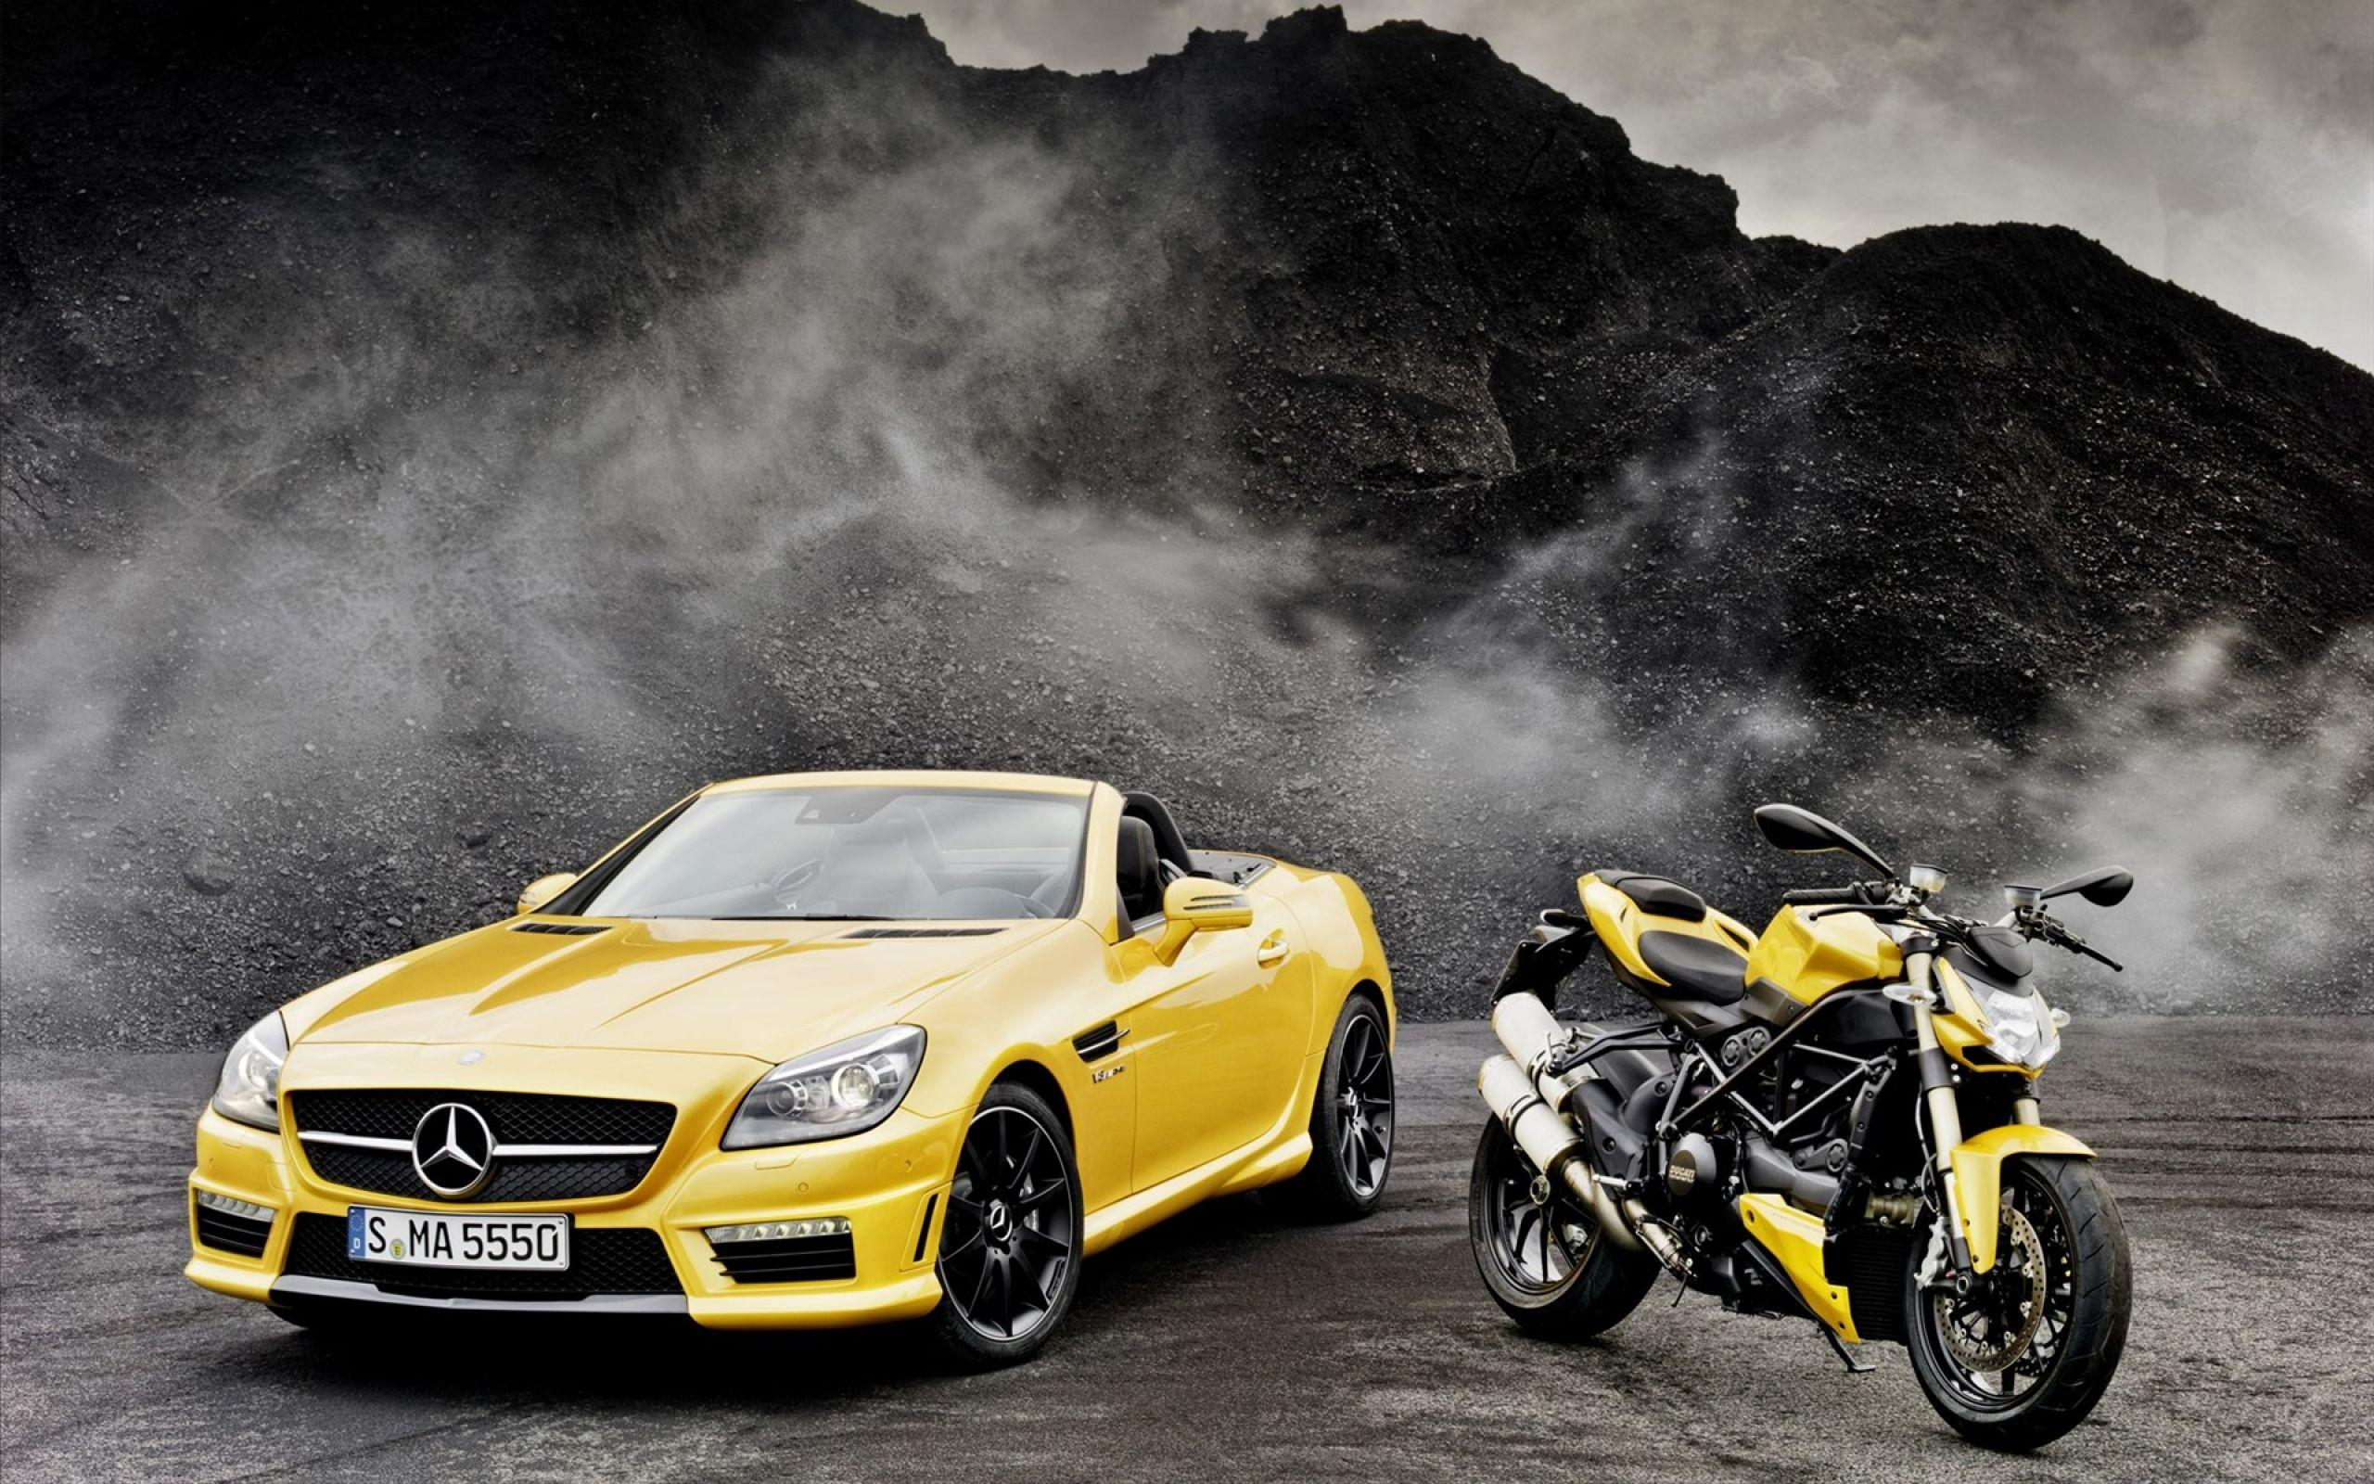
Scrap Data of Cars and Bikes

Slide 4
Scrap Data of Cars
To find which is best car ?

Slide 5
Meet
Rahul

Slide 6


www.Zigwheels.com
This Photo by Unknown Author is licensed under CC BY-SA

Slide 7

Renault
Kia / Hyundai
TATA
Maruti Suzuki
Datsun / Mahindra

Slide 8
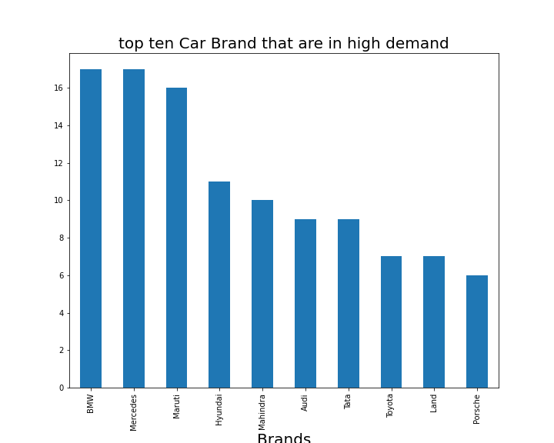
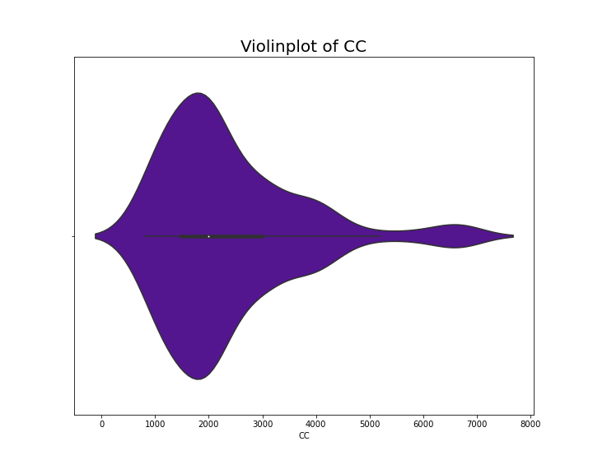
Cars Data Insights –
Top ten brands of car that are in high demands
75% of the cars are between 796 to 2993 CC
And 50% of the total cars are of Fuel-Type Petrol

Slide 9
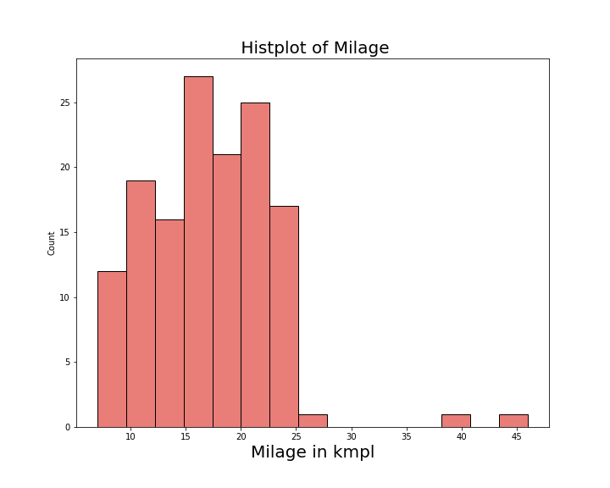
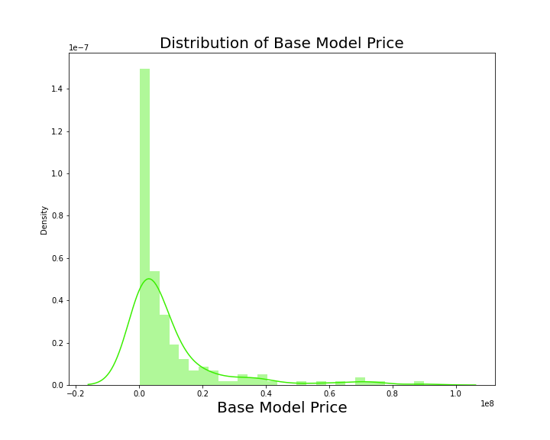
75 % of the cars have milage below 21 kmpl
50% of the cars are of less then 9 Lakhs.

Slide 10
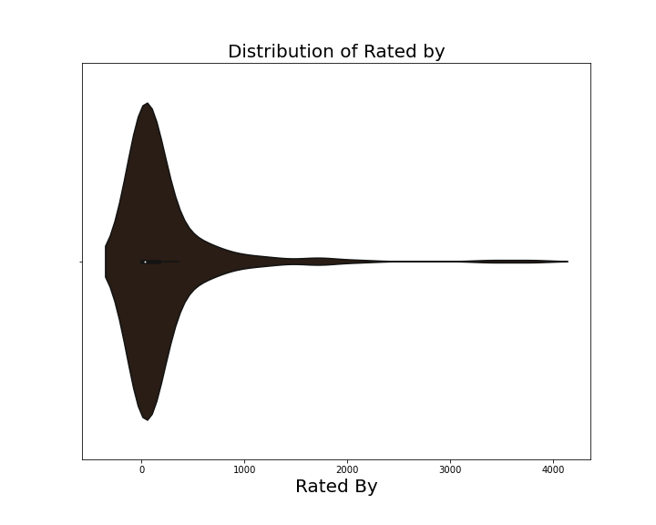
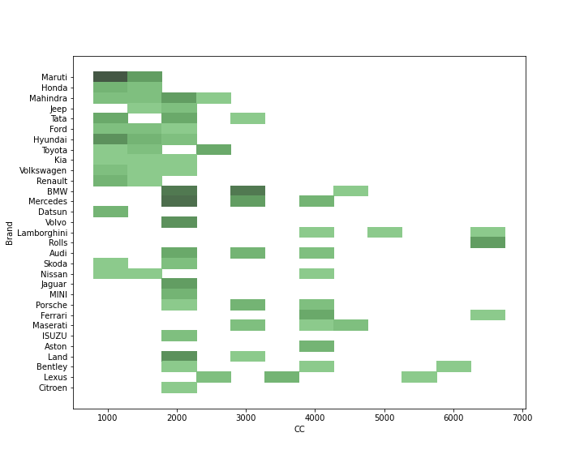
Some cars are really very famous, can be seen
by outliers, like Wagon R, Alto and Baleno of Maruti
Maruti, Renault and Datsun usually manufacture Low CC

Slide 11
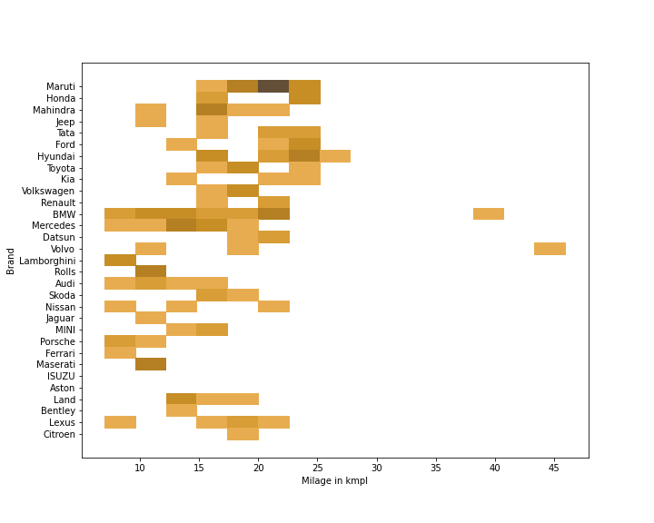
Majority of Maruti, Hyundai, Datsun cars have milage greater then 20 kmpl
Majority of BMW, Mercedes, Audi, Ferrari, Jaguar, Rolls-Royce, Lamborgini, Bantley, Porche, Mesarati cars have milage near to 12 kmpl or low
Mahindra, Tata, Land-Rover cars have mixed variants of low to high milage

Slide 12
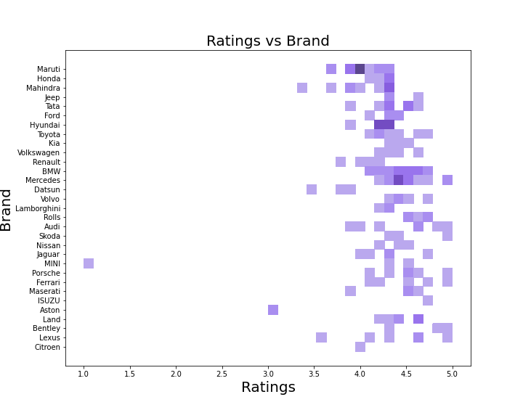
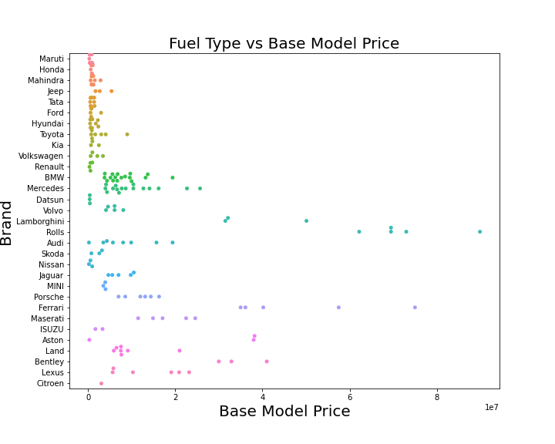
All cars of Maruti, Honda, Mahindra, Tata, Ford, Hyundai, Renault, Datsun are budget cars while the Maruti Suzuki are still most selling cars, but according to safety point of view customer rated Hyundai & Tata more then Maruti Suzuki.
All cars of BMW, Mercedes, Volvo, Lamborgini, Rolla-Royce, Audi, Porche, Ferrari, Mesarati are expensive cars, and Mercedes are most selling cars in luxury segment.

Slide 13
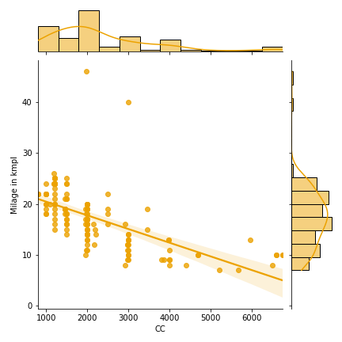
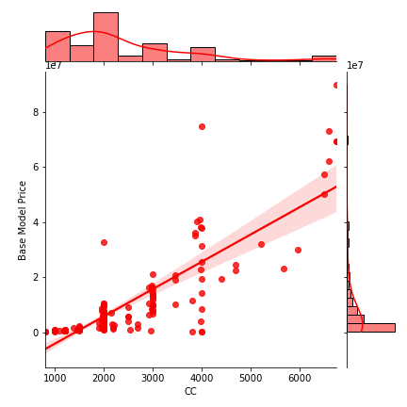
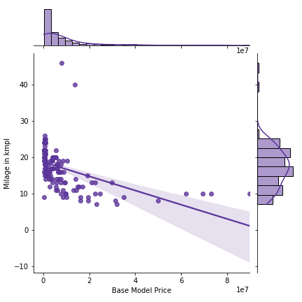
Some points to remember while buying cars:
Cars with Low CC tend to have high milage and vice-versa
Eg. Maruti WagaonR and Alto and all other budget cars
Cars with more CC tend to have more price and vice-versa
Eg. Mercedes, BMW and all other luxury cars
Car with Low milage tend to have High price and vice-versa
Eg. Lamborgini, Mesarati and all other sports cars

Slide 14


Which car suits to me (Rahul)?
“Finally my car search is over and I’m gonna book it Asap.”
“Yay, there are so many cars in my Wishlist”
Requirments: Price below 6 Lakh and milage should by greater than 20
Ohh great, I have a whole lot to choose from :
Maruti Suzuki : Swift, Baleno, Dzire, WagonR, Alto 800, Celerio, S-Presso and Celerio-X
Tata: Altros and Tiago
Hyundai: Aura and Grand i10
Renault: KWID
Datasun: Redi - Go

Slide 15
Scrap Data of Bikes
To find which is best bike ?

Slide 16
“Now, Its time to find out good bike for myself with same skill set which I used previously.”
“Remember me!, I used my excellent Data Scraping skill to find out the good car for me”
You guys already Know me, Yes I’m Rahul

Slide 17
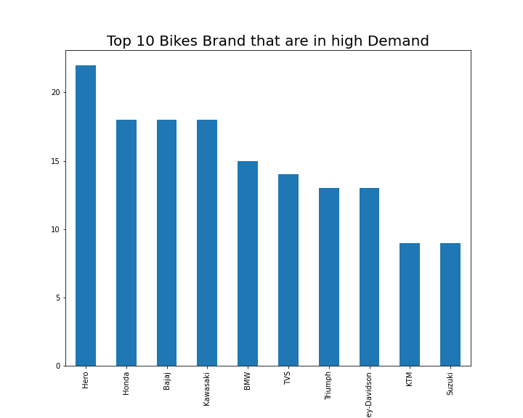
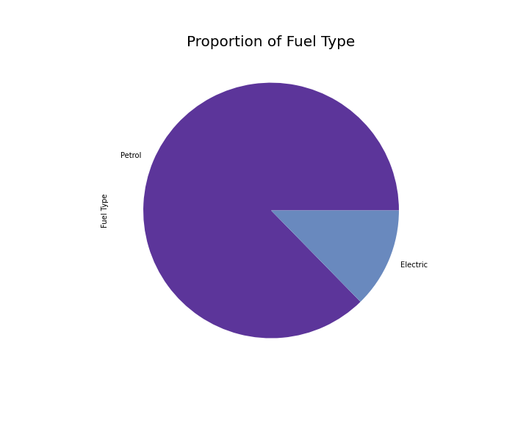
Bikes Data Insights –
Top ten Brands of bike that are in high demand
87% of the bikes are of Fuel Type Petrol

Slide 18
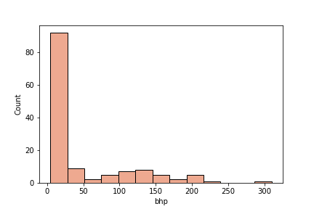
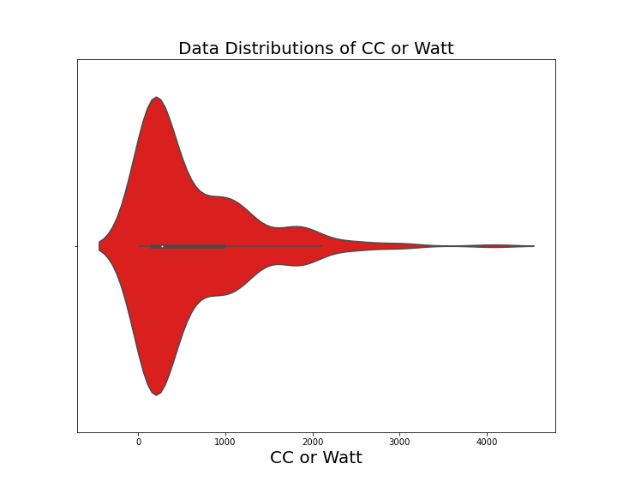
25% of the bikes are below 10 bhp
2. 50% of the bikes are below 300 CC

Slide 19
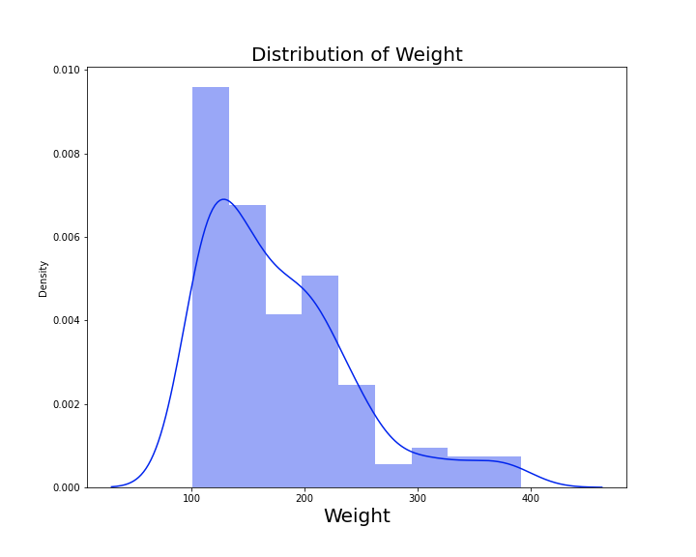
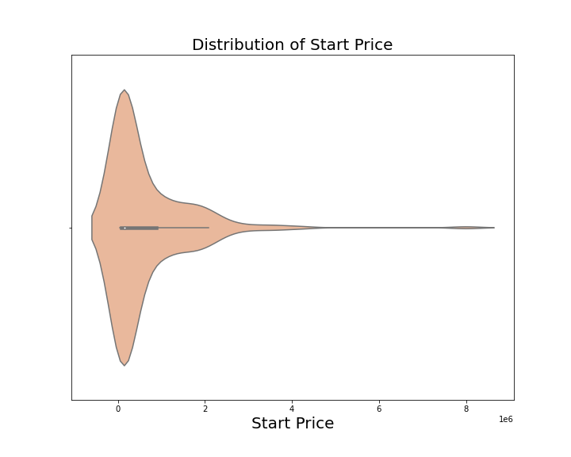
50 % of the bikes are below the weight of 160 kg
50% of the bikes are below 1.6 Lakhs

Slide 20
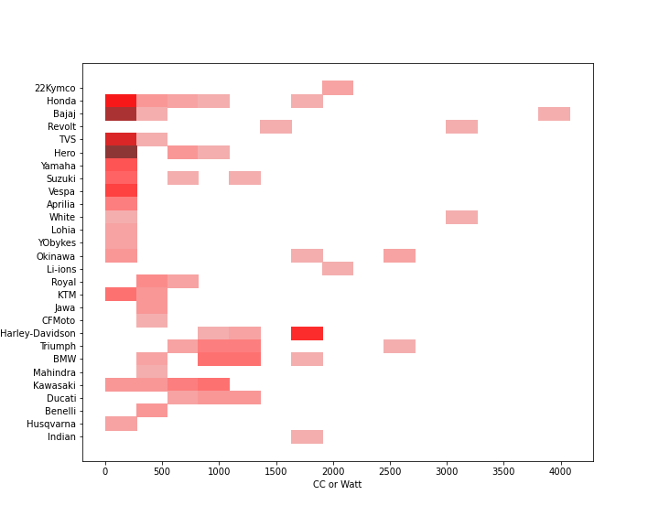
I wish some bikes are really very famous, like it took 6 months to me to get the delivery of my Royal Enfield Classic 350cc, Bikes that are high in demand.
Bajaj and Hero manufacture majority of Low CC bikes

Slide 21
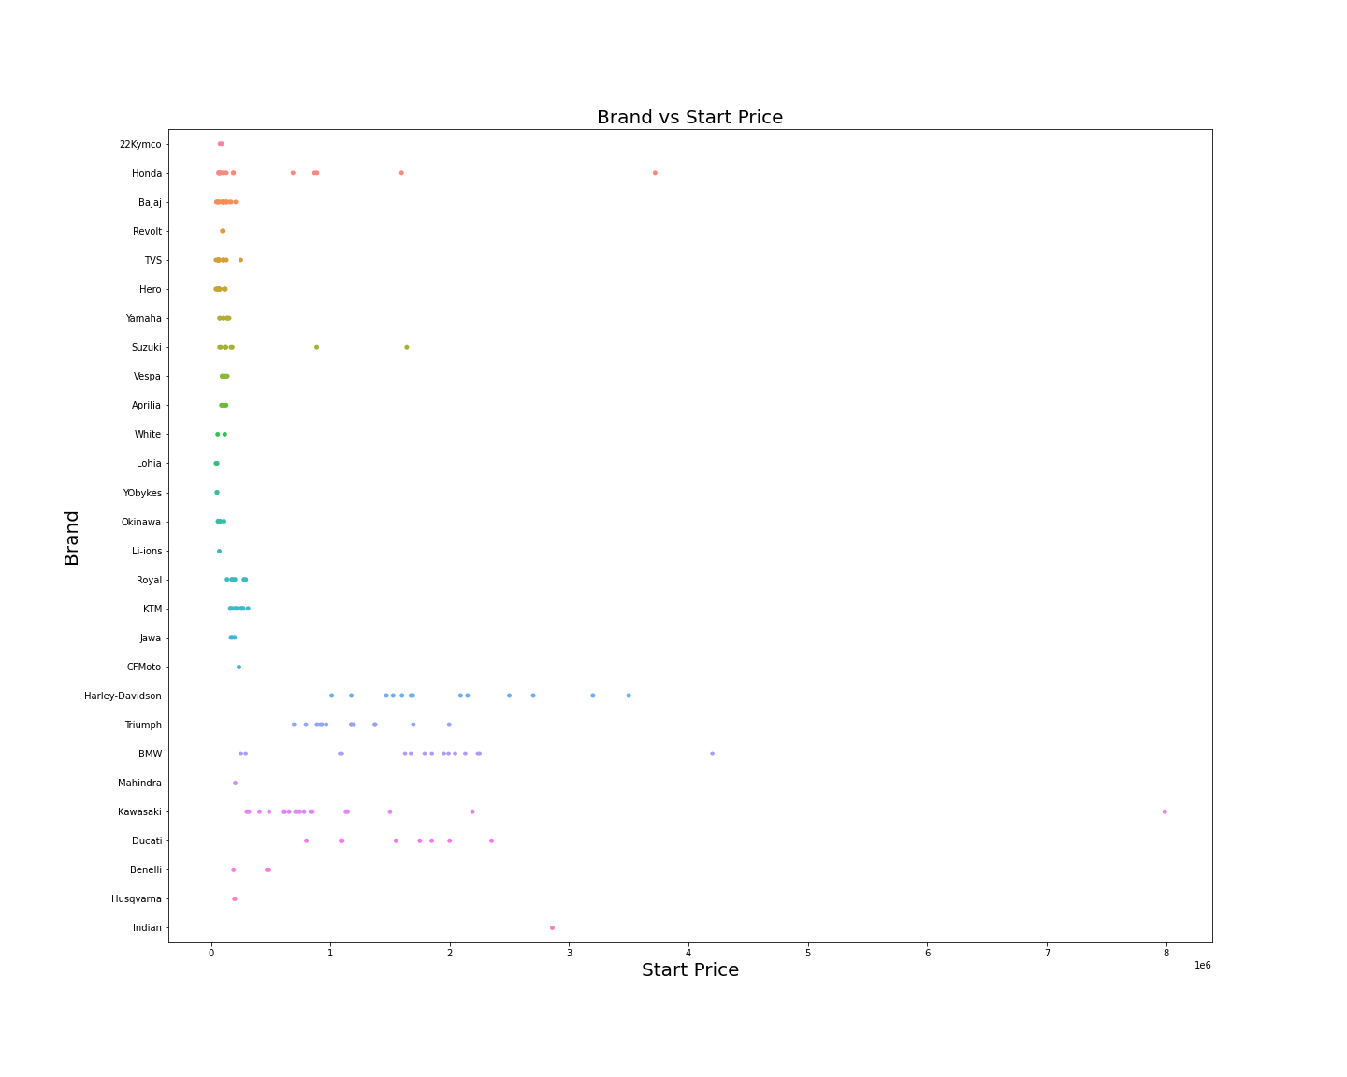
Bikes of Hero, TVS, Vespa, Yamaha, 22Kymco, Revolt, Jawa, Aprilia and Bajaj bikes are coming from low Low price segment
Bikes of Honda, Suzuki, KTM, Royal Enfield have bikes of both price segment high and low
Bikes of Kawasaki, BMW, Harley-Davidson, Triumph, Ducati are from high price segment¶

Slide 22
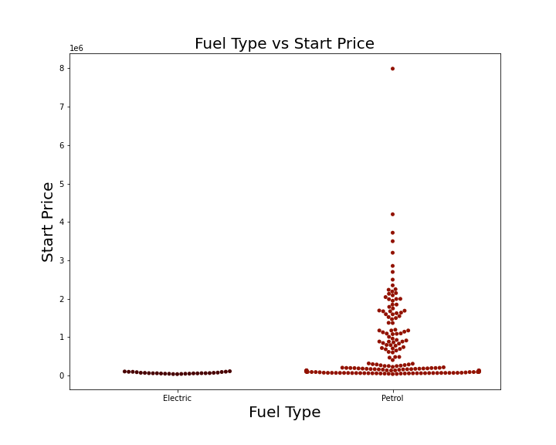
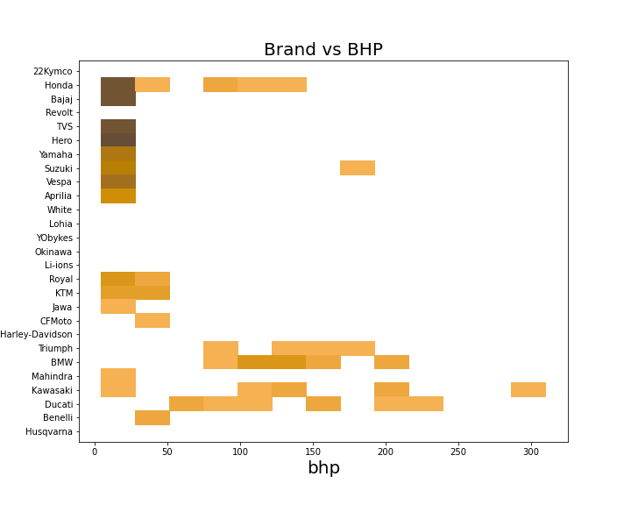
Electric bikes are usually cheaper then petrol bikes plus petrol
bikes are available in all price segments
Bajaj, Hero, Jawa used to manufactures bikes with Low Bhp
Honda, Suzuki, KTM, Rotal Enfield used to manufacture bikes
of all Bhp segments
Kawasaki, Ducati, Hardley-Davidson, Triumph and BMW usually
manufacture powerful bikes

Slide 23
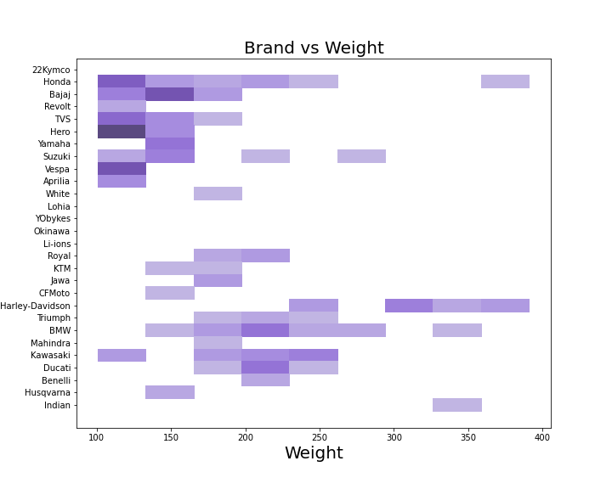
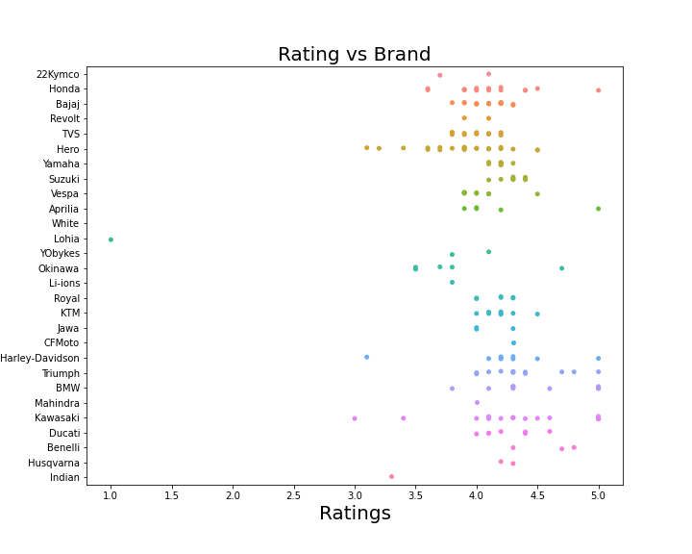
Vespa, Aprilia, 22Kymco, Revolt, CF Moto usually
manufacture light weight bikes
Honda, TVS and Bajaj has bikes in both light and heavy
Harley-Davidson, BMW, Kawasaki, Ducati, Royal Enfield
and Suzuki bikes are generally heavy in weight
Banelli, Ducati, Kawasaki, Triumph, Harley-Davidson, Royal Enfield,
Honda generally manufacture very good products
TVS, Hero, Honda, Bajaj, Yamaha, Suzuki, KTM, Vespa manufacture products
where some are higly liked whereas some are average products
Lohia products are not liked by customers very much

Slide 24
Which bike suits me (Rahul)?
Requirements: Price below 1 Lakh and CC greater than 150 and engine should be petrol
Ohh! inflation, I have only one bike to choose :
Honda: Unicorn
Ohh! Honda wow, our family riding this bike from generations

Slide 25
Future Scope of the project
Future scope of the project is that if anyone wants to search his best car or bike like Rahul he can follow the same insights.
Through these insights, the car and bike selling websites can also use this to find the most genuine product to sell, and company can update their data through these insights before the data has been obsolete
Through this insight companies can also follow Michel Potter’s 5 Forces Analysis

Slide 26
Fin
You guys are so awesome, Thank you
You know, you all are very great audience

